Slide 1

CPQ – Asia Alignment Design and Mock Up Nov ‘19
Colt confidential

Slide 2

Document Release and Change Log Details
CPQ Asia
Version Number | 0.2
Date | 27th Nov, 2019
Change log | Proposal document changes

Slide 3
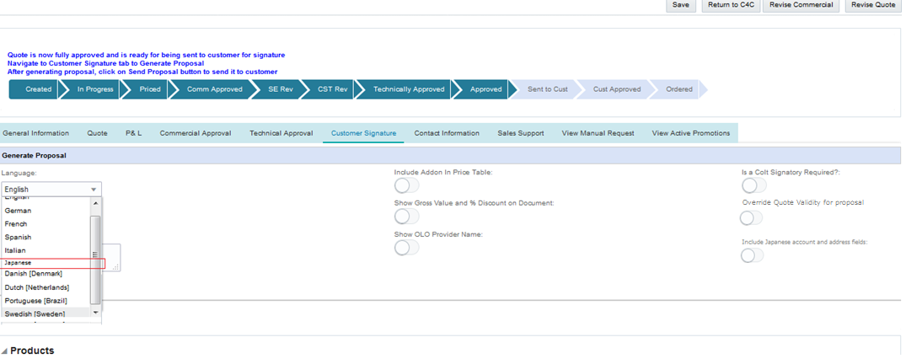
CPQ Asia : Proposal Generation- Japanese language selection
In Customer Signature tab, all users will be given Japanese language option to generate the proposal document.

Slide 4
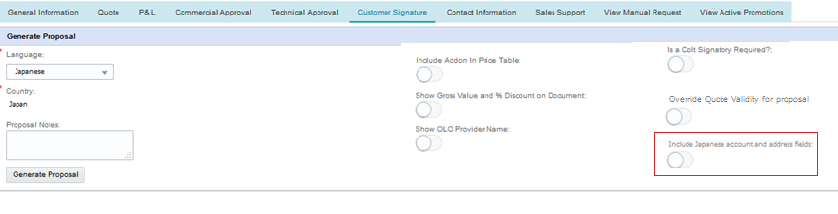
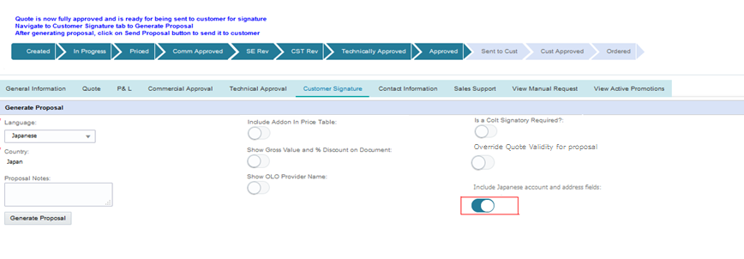
CPQ Asia : Proposal Generation- Japanese account name and address fields
A new Toggle button will appear asking user to include Japanese account and address fields.
The addition of toggle button is a global change.
When toggle button is selected by the user, informational message will appear on the screen “Please ensure that all the Asia account name and address fields are filled in Native Language”
Please ensure that all the Asia account name and address fields are filled in Native Language

Slide 5
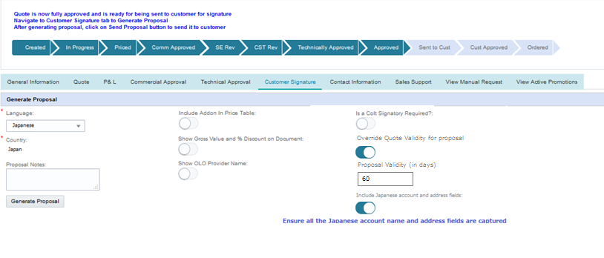
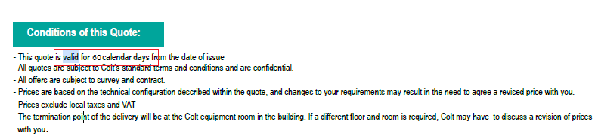
CPQ Asia : Proposal Generation- Customize quote validity
When toggle button is selected by the user for overriding quote validity in proposal, user will be allowed to enter no. of days for proposal validity.
No. of days entered as proposal validity will be shown in the proposal document validity section
Proposal validity days updated in proposal document as per the value entered above

Slide 6
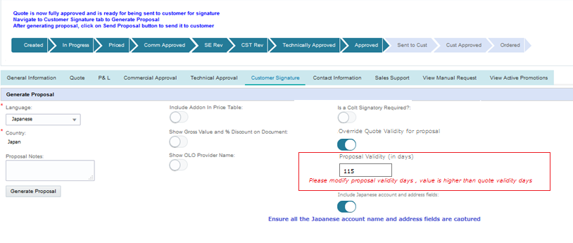
CPQ Asia : Proposal Generation- Customize quote validity
CPQ will do the below validations on the Proposal validity days fields
It is a numeric field
If proposal validity is higher than the quote validity, error message will be shown to the user to modify the validity days
Proposal validity calculation from the no of days entered should be less than or equal to the remaining quote validity period.

Slide 7
CPQ Asia : Proposal document: Additional Fields
Category | CPQ Attribute Name | Where in CPQ? | Attribute name in Proposal | Where in Proposal? | Comments/Logic
Generic | Account Name (Asia) | General Information -> Account Details | Customer Name | Quote Details Summary - > Customer Details | Introduce a toggle button as 'Include Japanese Native Address & Account Fields' which when clicked along with the selected Proposal language as 'Japanese', system would include them in the Proposal document else English. Informatory message to be shown "Please ensure that all the Japanese Native Account & Address fileds are captured" Please note that the Attribute names mentioned in column E should be considered as placeholder since when Proposal language will be Japanese, even the header / labels would be in Japanese.
Generic | Address (Asia) | General Information -> Account Details | Address | Quote Details Summary - > Customer Details | Same logic as mentioned in 1st point
Generic | a. Company Name A End (Asia) b. Company Name B End (Asia) | Contact Information | a. Company Name b. Company Name | Quote Details -> A-End / B-End | Same logic as mentioned in 1st point
Generic | Street Name, City, State, Building Name, Building Number, Room, Floor / Suite, Country, Post Code | Site Address -> A / B End Native Address | Address | Quote Details -> A-End / B-End | Same logic as mentioned in 1st point
Technical | a. Site Contact First Name A End b. Site Contact Last Name A End c. Site Contact First Name B End d. Site Contact Last Name B End | Contact Information | a, b Contact Name c, d. Contact Name | Quote Details -> A-End / B-End | Same logic as mentioned in 1st point
Generic | Customer Building Name | Site Address -> A / B End Address | Customer Building Name | Quote Details -> A-End / B-End
Generic | Customer Building Name (Asia) | Site Details-> A / B End Native Address | Customer Building Name | Quote Details -> A-End / B-End | Same logic as mentioned in 1st point
Product | Access Type = ULL Fibre | Site Details -> A / B End Site Details -> ULL Fibre | Access Type = ULL Fibre | Quote Details -> A-End / B-End
Product - All Data products in HK | Building Management Owner Charges | Site Details -> A / B End Site Details | Building Management Owner Charges | Site Features and Technical Details
Product - All Data products in HK | Building Management Owner Charges NRC | Line Item Grid, Config Grid | Building Management Owner Charges NRC | Charge Summary
Product - All Data products in HK | Building Management Owner Charge MRC | Line Item Grid, Config Grid | Building Management Owner Charge MRC | Charge Summary
Product - Wave Asia | Resilience = Backbone Protected | Site Details, Line Item | Resiliency = Backbone Protected | Quote Details
Product - Wave Global | Performance Reporting | Features | Performance Reporting | Overall Service Features and Other Required Features:
Product - Wave Global | Performance Reporting NRC | Line Item Grid, Config Grid | Performance Reporting NRC | Charge Summary
Product - Wave Global | Performance Reporting MRC | Line Item Grid, Config Grid | Performance Reporting MRC | Charge Summary
Proposal doc changes
https://coltinternal.sharepoint.com/:x:/r/sites/isu/Quote%20to%20Bill%20Programme/Quote/DocCollaboration/Shared%20Documents/CPQ%20Asia/Requirements/Requirements/Proposal,%20Translations,%20Quote%20Download/CPQ%20Asia%20-%20Proposal%20Analysis%20%26%20Translations.xlsx?d=w707406978d6149ba9fbb5d410f58e1a3&csf=1&e=NRAao3

